Slide 1



EVOLUTION OF WAGES IN MEXICO (2005-2023)
SEGMENTED BY ZONES, STATES AND SEX

Slide 2
Analysis Context
In a constantly evolving economic environment, understanting salary trends is essential to making informed decisions and developing effective strategies.
This analysis project focuses on the evolution of salaries in Mexico from 2005 to 2023, using official data from INEGI.Through this presentation, the areas of the country with the best salaries for both sexes will be identified, offering a detailed and comparative overview of salary opportunities in different regions.
The objective is to provide a clear view of how salaries vary geographically and by gender, helping to inform decisions that can contribute to a better understanting of labor market and the creation of more equitable policies.

Slide 3

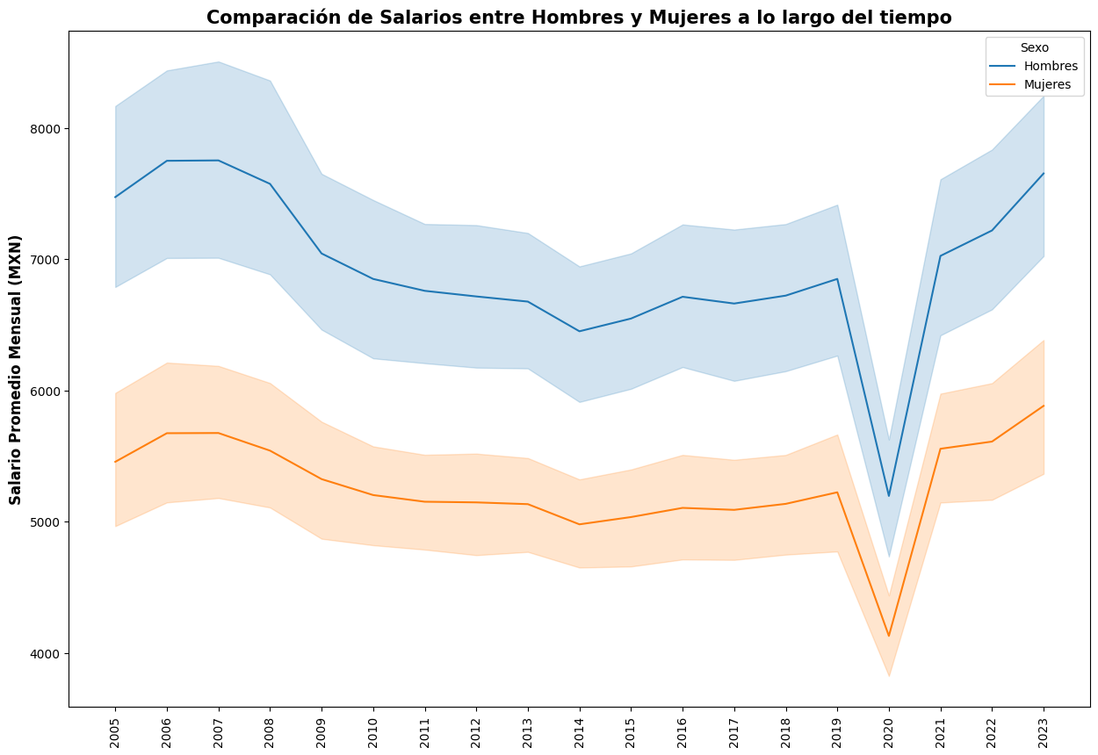
Evolution of the average monthly salary over time
A downward trend is observed in the average salary, indicaating an overall decline in purchasing power over time.

Slide 4

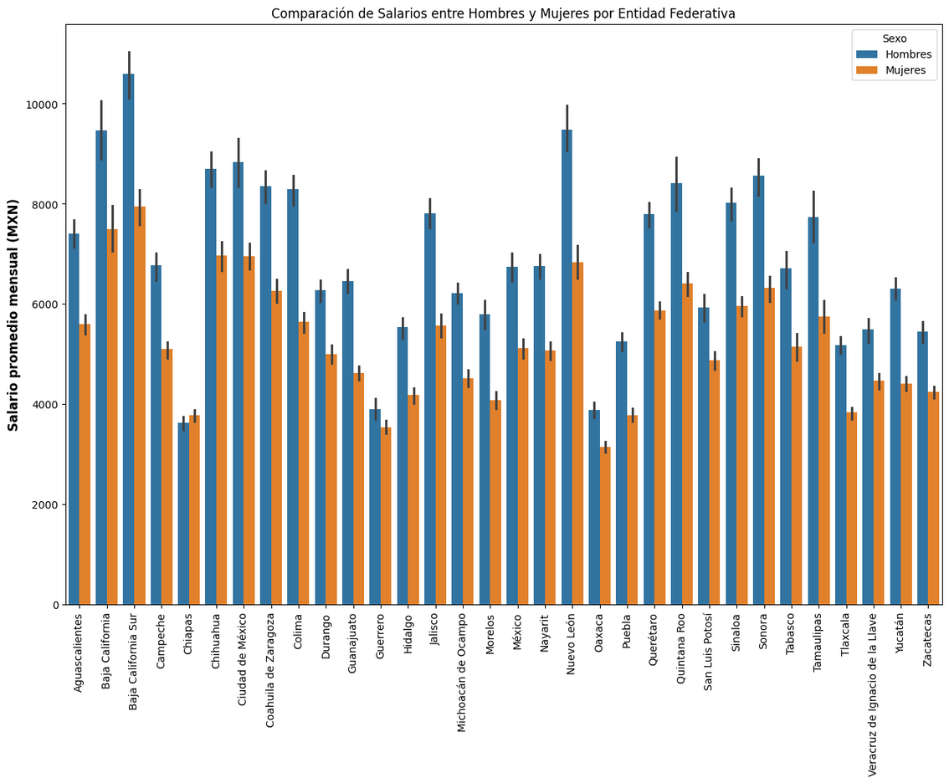
Salary gap by gender
Although the pay gap between men and women has decreased slightly over time, a significant difference in earnings remains, indicating the need to continue efforts toward greater pay equity.

Slide 5

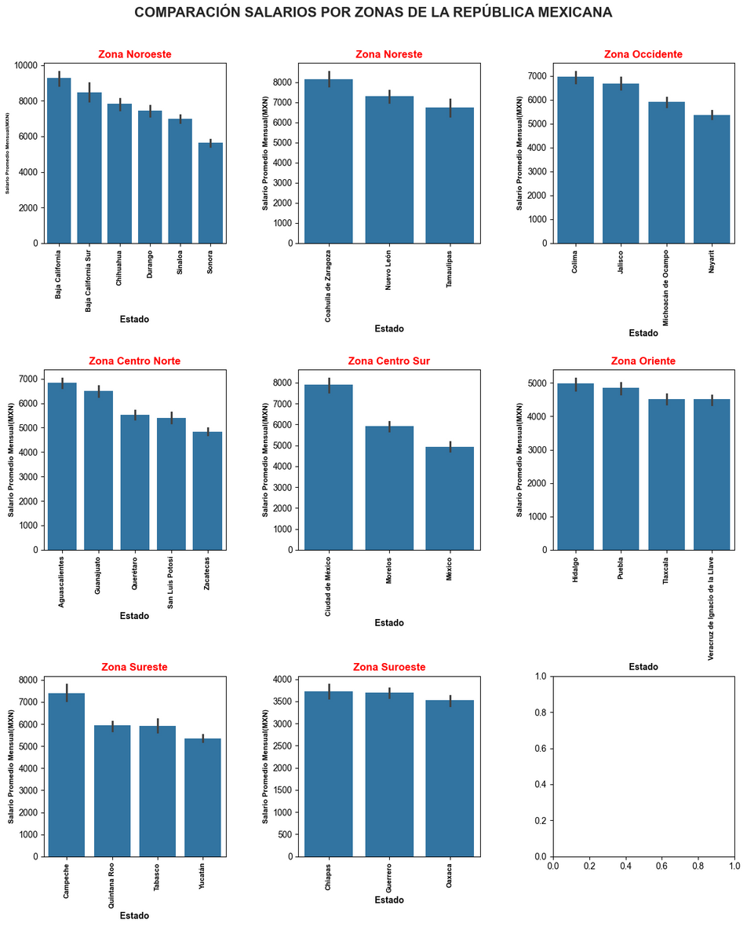
Segmentation by Zones and States
The northwest area of Mexico offers the highest salaries for both sexes, while the southwest area presents the lowest salaries, evidencing a significant variation in salary opportunities throughout the country.

Slide 6

Findings
Overall Downward Trend: Although there has been a moderate increase in average wages since 2005, the data shows an overall decline, especially during the COVID-19 pandemic.
Impact of COVID-19: In 2020, wages suffered a significant blow, exacerbating existing wage inequalities and severely affecting the economy of many mexican families.
Gender Pay Gap: Despite a slight closing in the pay gap between men and women, the difference remains notable, underscoring the importance of continuing efforts to achieve greater pay equity.

Slide 7
Explore the full Project
For more detailed and complete understanding of salary analysis in Mexico, I invite you to explore the full project on my Github. There you find the process of extracting, cleaning, loading and processing data, as well as the detailed visualizations that we have seen in this presentation.
GitHub: https://github.com/Qarant/Analysis-of-Mexican-Salaries-Over-Time

